Slide 1
Social Media reaction to major world events
Big Data Architecture Project Proposal
Bhavneet Soni

Slide 2
Introduction
We want to see how people react to major world events such as a terrorist attack, Sporting event, political or social marches etc.
Reaction will be classified as positive, negative and other emotions TBD.
For this we will try to capture data from the major social media APIs such as Twitter. (others like Facebook, Instagram etc. can be added to expand the scope of the project)
We will try to correlate different trends in tags, likes, shares and retweets with the users religious and political inclinations.

Slide 3
Amount of twitter data daily – estimated about 500 million tweets a day
Storage required
Social graph data
Interest graph
Time lines
Combined Is a pulse of the world
LIWC content analysis tool – positive and negative moods

Slide 4
Challenges & Workarounds
How to classify an event
An event will be defined as a twitter trend (#) with more than 100,000 people (mentions/ records) in a given time period.
What time frames?
How will we differentiate between different events occurring simultaneoulsy in the same time period and overlapping keywords.
How to collect the data and scrub the data to find meaningful and interpretable data

Slide 5
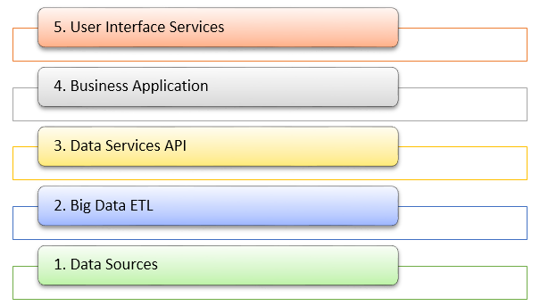
Project Overview
Notes:
We will give an over view of the
1. Data sources we will be using for the project
2. Then we will be discussing the ETL – Extraction transformation and loading of the data techniques we will be using to get the data in to a meaning full database
3. Data Services Api
4. Business Application
5. UI service – for user dashboards etc

Slide 6
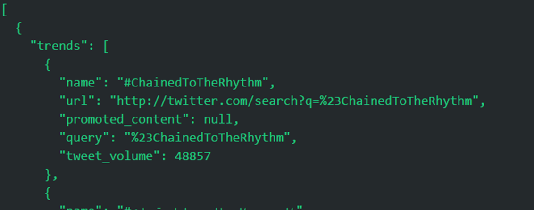
Data Sources
Twitter API
GET trends/place
We will try to get trend data for major cities
A typical response will look something like this

Slide 7
Database
Data retrieved from the API will be JSON
Will use MONGO DB to store the data
Data will be mined from the APIs at regular intervals (every couple of hours)
Data will be sharded and saved to partitions based on the places
We will use mongoShell to query data from the database

Slide 8
Analytics
Will use Oozie to run batch jobs on the data collected

Slide 9
UI Dashboard
Will use Tableau Desktop to design meaningful UI interface

